Slide 1
The latest activities related to the passive components in JAXA
15th October 2026
Soichiro OHNO, Akifumi MARU, Kensuke SHIBA and Koichi SUZUKI
Parts Program Group
Safety and Mission Assurance Department
Japan Aerospace Exploration Agency(JAXA)
Notes:
/Thank you for the kind introduction, my name is Soichiro Ohno from JAXA.
/Today, I’d like to give a presentation about the latest activities related to the passive components in JAXA.

Slide 2
Contents
Introduction
Qualified components activity
-Introduction of JAXA qualified components
-Comparison of JAXA/ESCC qualification test specification
-JAXA activity for qualification specification
COTS components activity
-Evaluation of COTS components of chip film capacitor for applying to space crafts
Overall summary
Notes:
/Topics of my presentation are shown here.
/Topics are introduction, Qualified components activity, COTS components activity and overall summary.

Slide 3
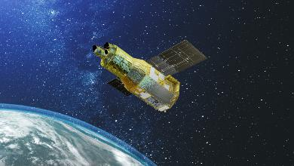
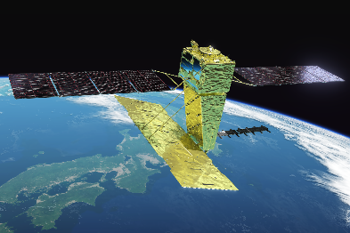
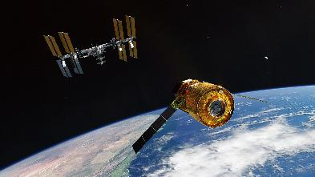
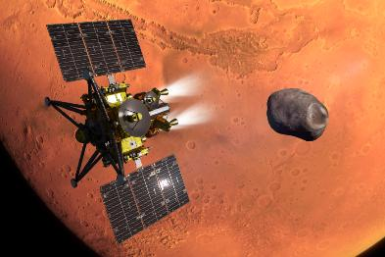
Introduction
JAXA has the EEE component qualification system for space applications.
Main purpose of qualification system
EEE Components commonly used in many space crafts are qualified.
Quality and reliability of commonly used EEE components are confirmed by qualification system in advance.
Qualification test(QT)
Screening test
Quality conformance inspection(QCI)
for confirmation of Stability of Manufacture product line
Space craft project which plans to use a qualified components does not any evaluation test before adopting.
On the other hand, the demand for adopting COTS component for space application is increasing due to its advantage of performance and cost.
JAXA has performed activities about qualification and evaluation COTS components for space application.
©JAXA
Notes:
/At first, I’d like to talk about introduction of our activities.
/JAXA has the EEE component qualification system for space applications.
/The main purpose is that space craft project doesn’t any evaluation test before adopting qualified components.
/On the other hand, the demand for adopting COTS components is increasing due to its advantage of performance and cost.
/Therefore, JAXA has been performed some activities about qualification and evaluation COTS components.
35 sec

Slide 4
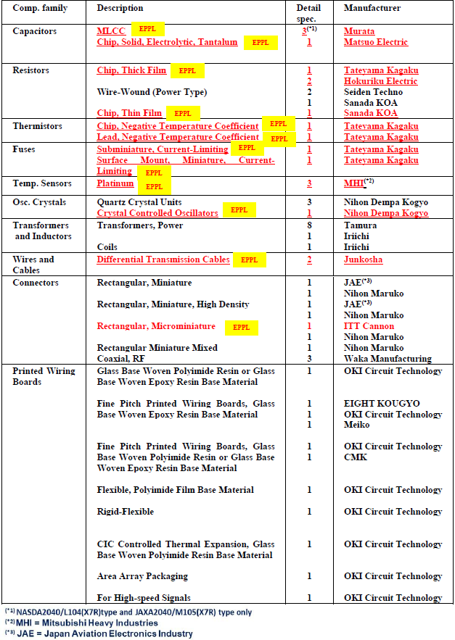
Introduction of JAXA qualified components
Table 1. List of JAXA qualified passive components.
There are total of 95 models of JAXA qualified components, of which 78 models are passive components.
※PCBs and materials such as thermal control films
are also included in JAXA qualified components.
As of July 2026, there are 15 passive component manufacturers which have abilities to manufacture the products to satisfy the requirements for space application defined by JAXA.
Notes:
/I’d like to talk about JAXA qualified components from this page.
/There are total of 95 models of JAXA qualified components, of which 78models are passive components.
/In JAXA, printed circuit boards and thermal control films are included in JAXA qualified components.
/As of July 2026, there are 15 passive components manufacturers.
/Table1 is list of JAXA qualified passive components.
/The components in red are currently listed in the EPPL.
33sec

Slide 5
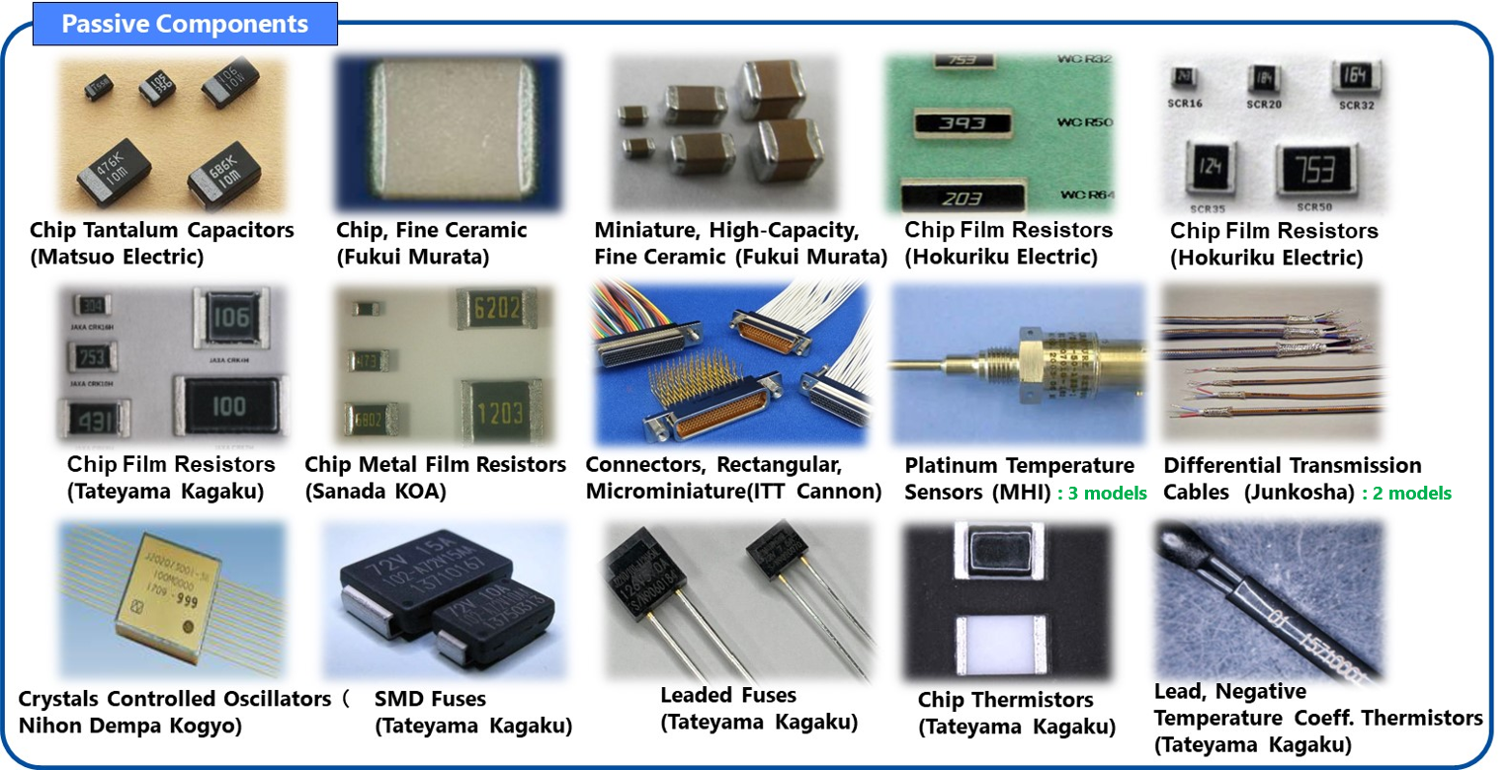
Introduction of JAXA qualified components
18 models of JAXA qualified components are listed in EPPL.
These components can be used for European space mission because their quality and the reliability
have been already verified by QT and QCI equivalence to ESCC.
Fig. 1. The JAXA qualified components listed in the EPPL.
Notes:
/18 models of JAXA qualified components are listed in EPPL.
/These components can be used for European space mission because their quality and reliability have been verified in advance.
13sec

Slide 6
Comparison of JAXA/ESCC qualification specification
As like examples of JAXA qualified components listed in EPPL, JAXA and ESA have conducted the activity related to the Cooperation Agreement on EEE Components for mutual usage of each component.
Mutual usage of Japanese components in Europe / European components in Japan has been promoted by ESA and JAXA:
To remove the barrier of mutual usage, ESA and JAXA held joint work to compare JAXA specifications and ESCC specifications for component qualification.
・To avoid duplicated development of similar components in Europe / Japan
・To ensure the availability of second source
Items to be compared
1. Overall difference in both qualification systems
2. Detail comparison of generic specifications
Notes:
/As like examples of JAXA qualified components listed in EPPL, JAXA and ESA have conducted the joint activity related to EEE components for mutual usage of each component.
/Mutual usage has purposes such as follows.
/To remove the barrier of mutual usage, ESA and JAXA held joint work to compare JAXA and ESCC specifications for component qualifications.
/Items to be compared were overall difference in both qualification systems and detail comparison of generic specifications.
42sec

Slide 7
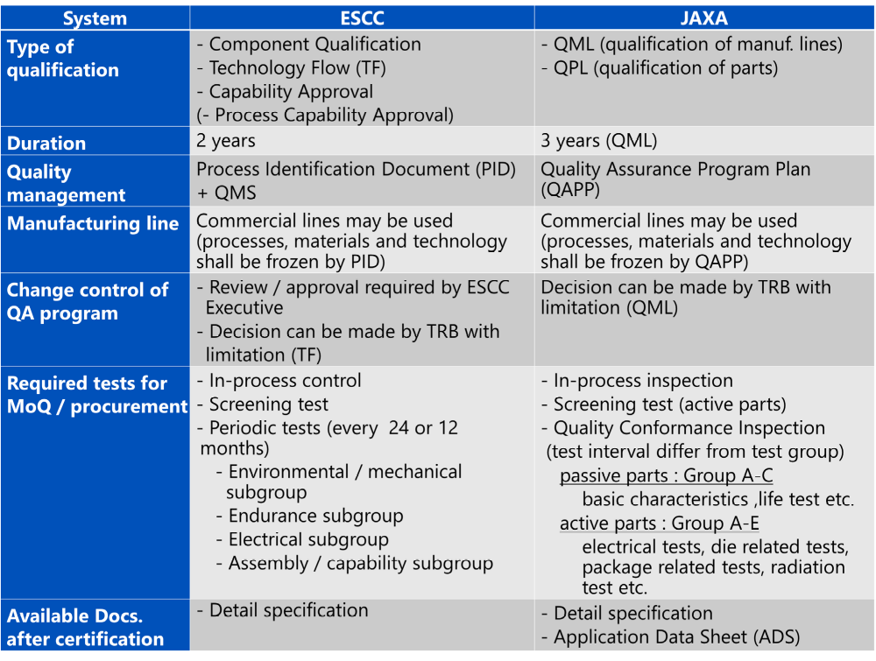
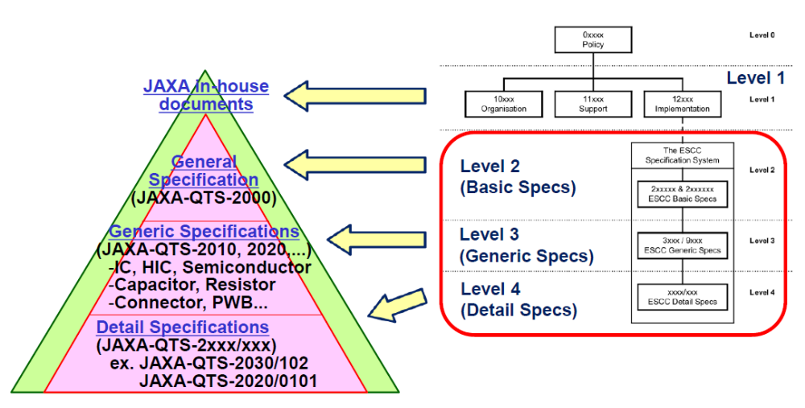
Comparison of JAXA/ESCC qualification specification
Comparison of document tree related to the qualification systems between JAXA and ESA is shown in Fig. 1.
It was confirmed that both qualification systems have similar document trees from Level 2 to Level 4.
Summary of the overall comparison each qualification system are listed in Table 2.
There is no major difference between JAXA system and ESCC system.
Therefore, both qualification systems are equivalence.
Table 2. comparison JAXA/ESCC qualification system.
Fig. 2. document tree of JAXA qualification system and ESCC qualification system.
MoQ=Maintenance of Qualification QMS=Quality Management System
Notes:
/The comparison results are shown here.
/Figure 1 is comparison between document trees in JAXA and ESA.
/It was confirmed that both qualification systems have similar document trees from Level 2 to Level 4.
/Table 2 is summary of the overall comparison of each qualification system.
/In this table, there is no major difference between JAXA system and ESCC system.
/Therefore, both qualification systems are equivalence.
34sec

Slide 8
JAXA activity for qualification specification
In addition to joint activity of comparison between JAXA and ESCC qualification system,
independent activity of periodic revising for generic specification (JAXA-QTS-2xxx) in JAXA
has been performed.
The purpose of revision
Keeping specifications up to date with advances in component technology
Keeping equivalence to other agency’s specification such as MIL and ESCC
Establishment of new appendix of QTS before qualifying new type of components
that has not been qualified in the past
Table 3. The list of revised QTS in FY2024 and FY2025.
Year | Revised QTS (Spec. Num. / component name)
FY2024 | QTS-2180 Platinum temperature sensors | QTS-2220 Crystal oscillator | QTS-2160 Thermistors
FY2025 | QTS-2140 Printed wiring boards | QTS-2110 Transformers and inductors | QTS-2060 Connectors*
*Discussion: FY2025
Establishment: FY2026
Notes:
/In addition to joint activity between JAXA and ESA, independent activity of periodic revising for generic specification in JAXA have been performed.
/The purposes of this activity are as follows.
/Keeping specifications up to date with advances in component technology
/Keeping equivalence to other agency’s specifications
/And, Establishment of new appendix of QTS for new components
/We have revised these 6 QTS from facial 2024 to 2025.
/These revisions are introduced briefly from next page.
45sec

Slide 9
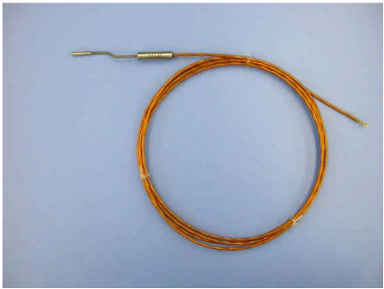
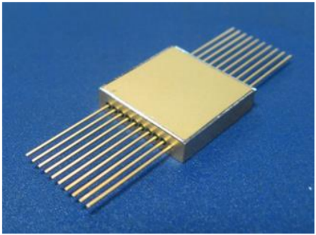
JAXA activity for qualification specification
Representative revision items
QTS-2180 Platinum temperature sensors
Revising due to the increasing trend of operational lifetime on geostationary satellites from 10 to 15 years.
Qualification test conditions were updated to ensure reliability for a 20-year lifetime, including pre-launch storage.
Temperature cycling and humidity resistance condition
Fig. 3. An example of the JAXA qualified
platinum temperature sensor.
QTS-2220 Crystal oscillator
In previously, JAXA didn’t have a dedicated specification for crystal oscillators, qualification of crystal oscillators was conducted by hybrid IC specification.
Establishment of a dedicated crystal oscillators specification(QTS-2220) to reduce qualification costs and optimize the test program.
Referring to MIL standards, QT/QCI sample sizes were reduced.
Frequency-aging screening was added based on ESCC specification.
Fig. 4. The JAXA qualified
crystal oscillator.
Notes:
/Ok, I’d like to introduce representative revision items.
/For the platinum temperature sensors QTS, temperature cycling test and humidity resistance test conditions were updated.
/For the crystal oscillators, a new dedicated crystal oscillators QTS was established.
1min 9sec

Slide 10
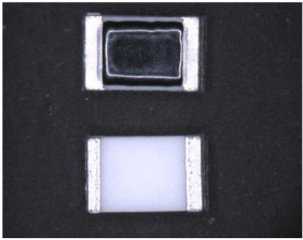
JAXA activity for qualification specification
Representative revision items
QTS-2160 Thermistors
Removement of mechanical stress tests for chip NTC thermistors.
Based on device structure and test results in the past showing no mechanical-stress-related failures, these requirements were considered unnecessary.
Fig. 5. The JAXA qualified thermistors, chip, negative temperature coefficient.
QTS-2140 Printed wiring boards
Clarification of unclear requirements and maintenance of equivalency with the latest ECSS specification.
Undercut inspection requirements were optimized based on manufacturing method,
allowing omission for undercut-free processes in QCI while retaining QT requirements.
The TH plating thickness evaluation method was updated to align with the revised ECSS-Q-ST-70-60C specification from the 3 points average calculation to minimum thickness measurement.
Notes:
/Next.
/For the thermistors, mechanical stress tests were removed.
/For the Printed wiring boards, omission of undercut inspection in QCI was allowed when undercut-free process was adopted.
/And, the TH plating thickness evaluation method was updated.
54sec

Slide 11
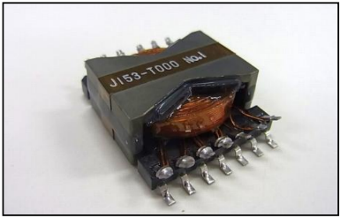
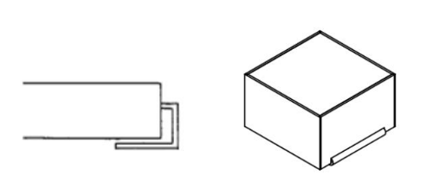
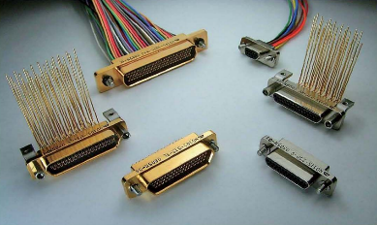
JAXA activity for qualification specification
Representative revision items
QTS-2110 Transformers and inductors
Enhancement of reliability verification and inclusion of new device types.
X-ray inspection was added to QT and QCI screening after thermal shock testing to verify workmanship and detect potential environmental test effects.
The inward-form lead surface-mount type inductors were added in specification.
Fig. 6. An example of the JAXA qualified transformers.
Fig. 7. Terminal structure of inward form lead.
QTS-2060 Connectors
Establishment of a new appendix J for cable assemblies based on
existing QTS requirements and ESCC specification.
The qualified cable assemblies consist of following connectors and cables.
Connectors: Rectangular microminiature connectors(QTS-2060 appx. F)
Cables: RF coaxial cables/FEP insulated wires/fluorinated polyimide insulated wires/
differential transmission cables
(JAXA qualified components, MIL failure rate level S, R, D, C, GSFC S311 and ESCC level B, C)
Fig. 8. Examples of the JAXA qualified rectangular microminiature connectors.
Notes:
/For the transformers and inductors, X-ray inspection was added to QT and QCI screening.
/And, the inward-form lead surface-mount type of inductors was added to the specification.
/For the Connectors, a new appendix J for cable assemblies was established.
45sec
4-11 : 7min 7sec

Slide 12
Evaluation of COTS components of chip film capacitor for applying to space crafts
Introduction of COTS Activity
Commercial Off-The-Shelf (COTS) components are expected to apply to the latest space applications due to its advantage of performance and cost.
The parts program group evaluates selected COTS to verify whether they have enough tolerance to the space environment in order to minimize the risk.
Based on the evaluation results, we establish guideline for application of COTS components to spacecrafts.
The guideline includes evaluation results, identified failure modes and precautions for use.
In the past, we have conducted evaluation for the flip chip IC, Polymer tantalum capacitor, voltage-controlled crystal oscillator and solid-state battery.
Lately, with the increase in the necessary electric power for spacecraft, there is a need for film capacitors with high rated voltage, large capacitance and no voltage dependence of capacitance.
In FY2024 to 2025, evaluation test for chip film capacitor was conducted.
Notes:
/Next, I’d like to introduce COTS activity.
/COTS components are expected to apply to the latest space applications due to its advantage of performance and cost.
/Our group have evaluated selected COTS components to verify whether they have enough tolerance to the space environment.
/Based on the evaluation results, we establish guideline for application of COTS to spacecrafts.
/This guideline includes these contents.
/In the past, we have conducted evaluation for some components.
/Lately, with the increase in the necessary electric power for spacecraft, there is a need for film capacitors having high rated voltage, large capacitance and no voltage dependence of capacitance.
/In facial 2024 to 2025, evaluation test for chip film capacitor was conducted.
1min 2sec

Slide 13
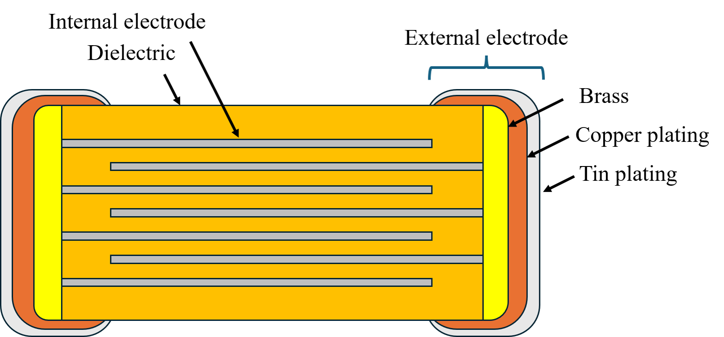
Overview and specification of target component
Table 4. The specification of evaluated capacitor
Component : Chip film capacitor
Structure: Stacking structure
Material:
・Dielectric: Acrylic Polymer
・Internal electrode: Al
・External electrode: Brass(Cu-Zn)/Cu/Sn
Product specification
Chip size | 4532
Rated voltage | 16V DC
Range of capacitor | 4.7µF
Capacitance tolerance | ±20%
Insulation resistance | At least 300 MΩ·μF
Dissipation factor | At most 1.5%
Range of temperature | -55℃~+125℃
Fig. 9. Schematic diagram of chip film capacitor.
Notes:
/This page shows overview and specification of the target component.
/The component is chip film capacitor having stacking structure as shown in figure 9.
/The materials of chip film capacitor are as follows.
/Dielectric is acrylic polymer
/Internal electrode is aluminum
/External electrode consists of Brass, Copper plating and Tin plating.
28sec

Slide 14
Evaluation Test Contents and Overview Results
Evaluation test was determined based on the QTS-2040 Appendix M for MLCC.
→・JAXA doesn’t have the specification for evaluation of film capacitor.
・Chip film capacitor has multilayer structure and SMD form as MLCC.
Table 5：Evaluation tests and result
Result of the tests
Test |  |  | Result
Group | Order | Item
I | 1 | Thermal shock and voltage aging | 〇
 | 2 | Insulation resistance(+125℃) | 〇
 | 3 | Dielectric withstanding voltage | 〇
 | 4 | Insulation resistance(+25℃) | 〇
 | 5 | Capacitance | 〇
 | 6 | Dissipation factor | 〇
II | 1 | Externals, dimensions, and marking | 〇
 | 2 | DPA | 〇
III | 1 | Solderability | 〇
 | 2 | Resistance to soldering heat | 〇
IV | 1 | Voltage-temperature characteristics | 〇
 | 2 | Moisture resistance | ×
V | 1 | Humidity, steady state, low voltage | ×
VI | 1 | Life | ×
VII | 1 | Barometric pressure | 〇
VIII | 1 | Thermal shock and immersion cycling | ×
X | 1 | Thermal shock(I) | 〇
XI | 1 | Shear (destructive) | 〇
 | 2 | Substrate bending | 〇
The screening and part of the LAT were passed.
Failures were identified in tests related to moisture and temperature stress.
Cross sectional analyses were performed for failure samples.
As representative evaluation tests,
the results and Cross-sectional
analyses for moisture resistance and life test are
shown on the following pages.
Group Ⅰ：Screening, Ⅱ～Ⅺ：LAT
Notes:
/Ok, This page shows evaluation test contents and overview results.
/The evaluation test was determined based on the specification for MLCC.
/Because we don’t have the specification for film capacitors.
/In addition, chip film capacitors have multilayer structure and SMD form as MLCC.
/Ok, The screening and part of the LAT were passed.
/However, failures were identified in tests related to moisture and temperature stress.
/Cross sectional analyses were performed for failure samples.
/As representative evaluation tests, the results and cross-sectional analyses for moisture resistance and life test are shown on the following pages.
52sec

Slide 15
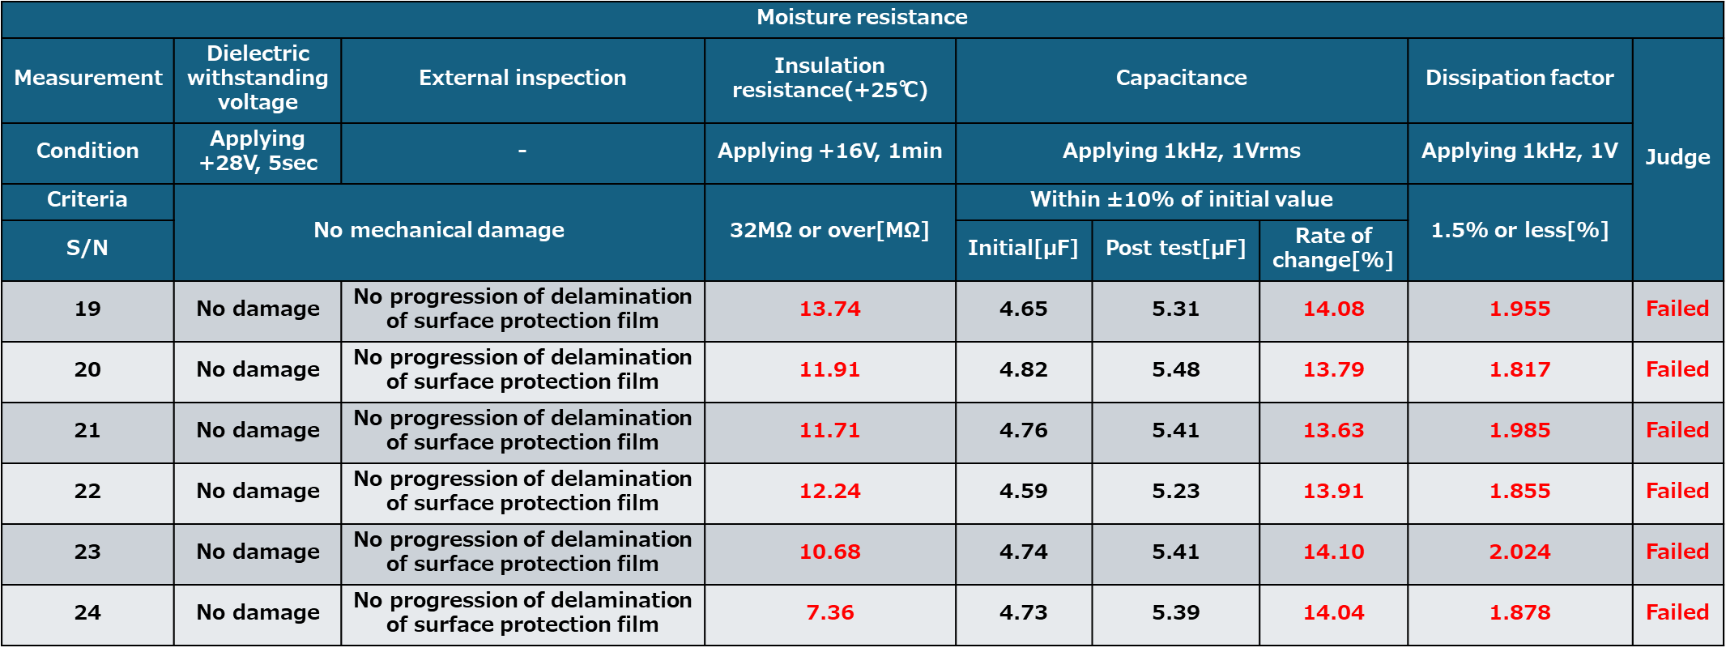
Evaluation Tests Result
Moisture resistance
Moisture resistance test was performed under the following condition. (Representative)
Table 6 : Condition of moisture resistance
Test | Test condition
Moisture resistance test | ・Test method：MIL-STD-202 TM106 ・Temperature and humidity : +65℃/95%RH ⇔ 25℃/95%RH ・Number of Cycles : 20 cycles was applied to components under the condition that single cycle is 24 hours. ・Applied voltage：Rated voltage during first 10 cycles. ・Measuring after the test：External inspection, Capacitance, Dielectric withstanding voltage, Insulation resistance(+25℃) and Dissipation factor
All of 6 samples failed electrical criteria though passed external inspection criteria.
Table 7 : Results of moisture resistance test
Notes:
/This is result of the moisture resistance.
/Table 6 is test condition.
/Table 7 is test results.
/All of 6 samples failed electrical criteria of Insulation resistance, capacitance and dissipation factor.
18sec

Slide 16
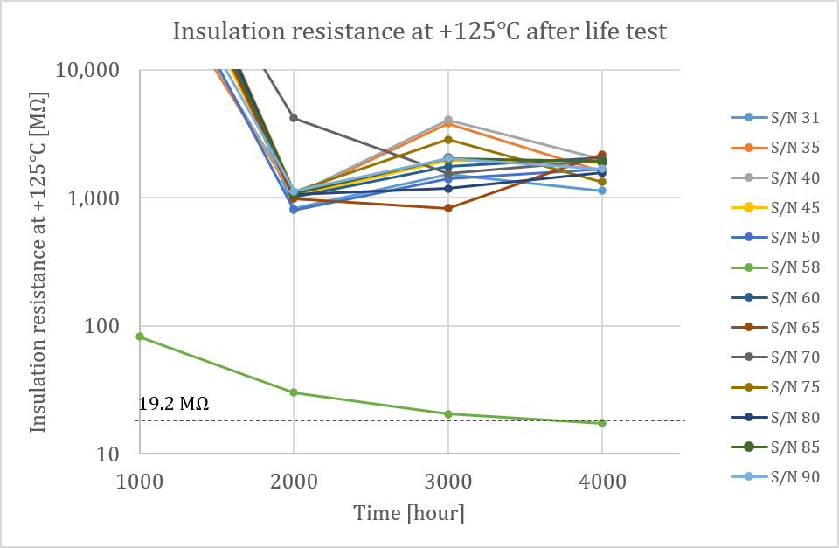
Evaluation Tests Result
Life Test
Life test was performed under the following condition.
Table 8 : Condition of Life test
Test | Test condition
Life | ・Test method：MIL-STD-202 TM108 ・Temperature： +125℃ ・Duration： 4000 hours ・Applied voltage：+16V(Rated voltage) ・Measuring after the test：External inspection, Capacitance, Dielectric withstanding voltage, Insulation resistance(+25℃, 125℃) and Dissipation factor
One of 60 samples failed insulation resistance(@125℃) criteria after 4000 hours life test.
Other electrical characteristics in S/N 58 were satisfied criteria.
Table 9 : Results of the insulation resistance after life test in S/N 58.
Item | Insulation resistance(125℃)
Condition | 16V
Criteria | 19.2MΩ or over
Duration | 1000h | 2000h | 3000h | 4000h
s/n 58 | 82.1 | 30.2 | 20.5 | 17.4
Fig. 10. Trend of the insulation resistance at +125℃ with life test duration.
Notes:
/Next, this is the result of life test.
/One of the 60 samples failed insulation resistance at 125-degree Celsius criteria after 4000hours life test.
/The sample was No 58.
/Figure 10 is trend of the insulation resistance.
/Broken red line is lower limit.
/After 4000hours, insulation resistance fell below that limit.
33sec

Slide 17
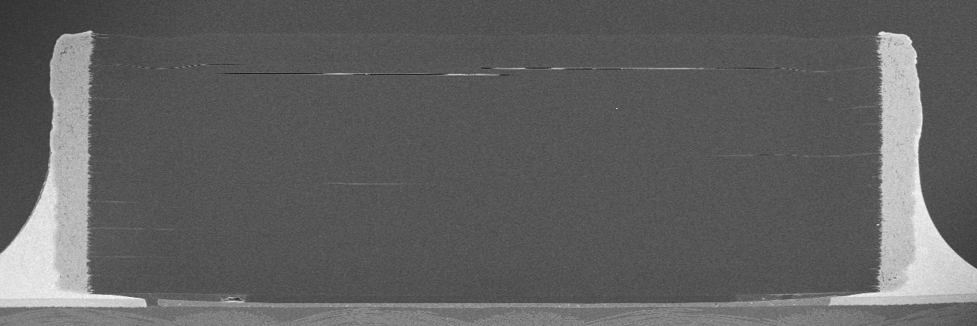
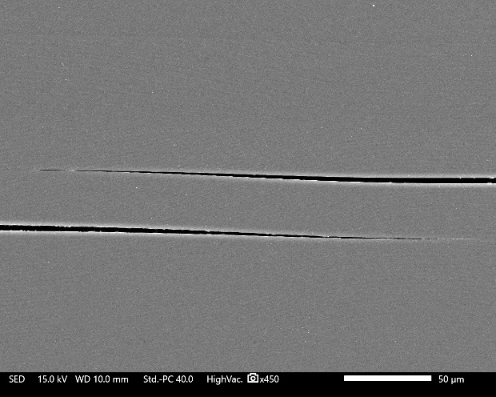
Structural Analysis
Moisture resistance
Some delaminations were observed in the sample that failed the moisture resistance.
It is estimated that one of the possible causes of the degradation in electrical characteristics is the following process.
1. During the test, moisture penetrated into dielectric and generated delamination.
2-1. The moisture induced electrical conduction, resulting in failure of insulation resistance and dissipation factor.
2-2. In addition, the moisture caused additional capacitance, leading to capacitance failure.
Fig. 11. SEM images of S/N 24 after the moisture resistance.
Notes:
/This page shows structural analysis of moisture resistance test sample.
/Some delaminations were observed in the failed sample.
/It is estimated that degradation of electrical characteristics occurred as following process.
/During the test, moisture penetrated into dielectric and delamination.
/Then, the moisture induced electrical conduction, resulting in failure of insulation resistance and dissipation factor.
/In addition to that, the moisture caused additional capacitance, leading to capacitance failure.
44sec

Slide 18
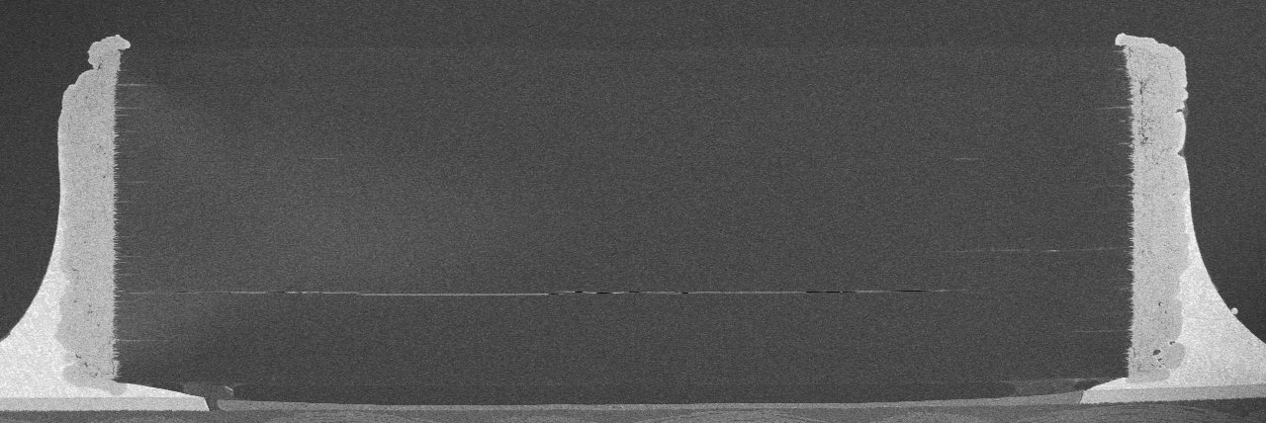
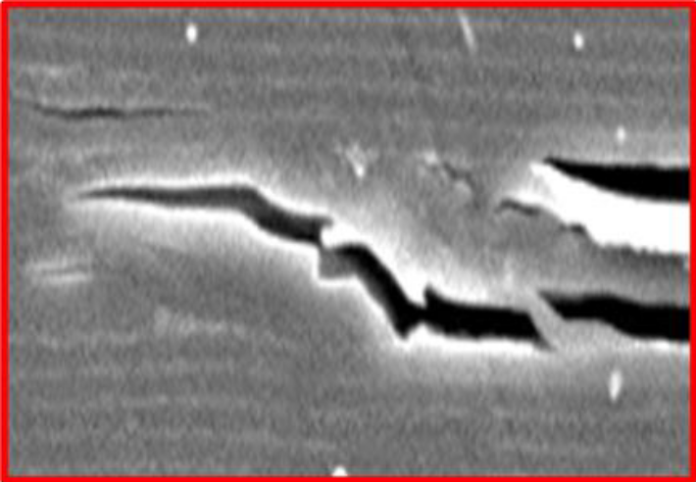
Structural Analysis
Life test
Delamination across multiple layers was observed in the S/N 58 which failed the life test.
It is estimated that one of the possible causes of degradation in the insulation resistance is the following process.
1. During the life test, the dielectric was oxidized at high temperature.
2. Adhesion between layers was degraded by oxidation, resulting in the delamination mentioned above.
3. This delamination induced insulation resistance failure.
Fig. 12. SEM images of S/N 58 after the life test.
Notes:
/This page shows the structural analysis of a sample which failed the life test.
/Delamination across the multilayers was observed in the sample 58.
/It is estimated that one of the possible causes of the insulation resistance degradation is following process.
/During life test, the dielectric was oxidized at high temperature.
/Then, adhesion between layers was degraded by oxidation, resulting in the delamination.
/Finally, this delamination induced insulation resistance failure.
43sec

Slide 19
Summary and Future COTS activity
Summary about evaluation of the COTS chip film capacitor
We evaluated the chip film capacitor based on MLCC qualification test.
It is confirmed that the component has resistance to solder mounting and mechanical stress required
in space application.
It is identified that the component is sensitive to moisture stress.
It was found that one sample failed in insulation resistance at 125℃ after 4000 hours life test.
It is estimated that resistance of moisture penetration and thermal oxidation caused these failure.
・Evaluation results, related failure modes and precautions for use of chip film capacitor as COTS components
for spacecraft will be added to the JERG-0-052 handbook.
Future Activity
We will evaluate 2 another types of film capacitors that have improved moisture resistance and suppress thermal oxidation.
1. A model with a different dielectric material as well as thicker design of dielectric
to improve resistance of moisture stress and suppression of thermal oxidation
2. A model with a protective package to improve resistance of moisture stress model
Evaluation results and precautions for using in space applications will be added to the JERG-0-052 handbook.
If enough tolerance for space environment is confirmed in these film capacitors, we will consider qualifying them.
Notes:
/So, here is the summary and future activity of COTS evaluation.
/We have evaluated the chip film capacitor.
/It is identified that the component is sensitive to moisture stress.
/And, It was found that one sample failed after 4000 hours life test.
/It is estimated that resistance of moisture penetration and thermal oxidation caused these failures.
/We will include evaluation results, related failure modes and precautions for use of it to the JERG-0-052 handbook.
/In the future, we will evaluate 2 another types of the film capacitors that have improved moisture resistance and suppress thermal oxidation.
/One model has a different dielectric material as well as thicker design of dielectric to improve resistance of moisture and suppression of thermal oxidation.
/The other one has a protective package to improve resistance of moisture stress.
/Then, these evaluation results and precaution for using in space application will be added to guideline.
/If enough tolerance for space environment is confirmed in these film capacitors, we will consider qualifying them.
1min 30sec

Slide 20
Overall summary
We introduced JAXA activities related to qualification system, qualified components and COTS components.
It was verified that the JAXA and ESA qualification system is equivalence through the previous JAXA-ESA cooperation framework.
The JAXA-QTSs for qualified components have been revised periodically.
-FY2024: Platinum temperature sensors/Crystal oscillator/Thermistors
-FY2025: Printed wiring boards/Transformers and inductors/Connectors
The COTS chip film capacitor was evaluated.
-It was verified that this component has enough resistance to solder mounting and mechanical stress
required in space application.
-It is identified that evaluated chip film capacitor is sensitive to the moisture stress.
-It is estimated that delamination which was observed after the 4000 hours life test degrades insulation resistance.
-Two other types of film capacitor which are expected to have resistance to moisture stress and
to prevent appearance of delamination have been planning to evaluated to the next.
Notes:
/Here is overall summary.
/We introduced JAXA activities related to qualification and COTS components.
/It was verified that the JAXA and ESA qualification system is equivalent through the previous JAXA-ESA cooperation framework.
/And, the JAXA QTS for qualified components have been revised periodically.
/Ok, I introduced chip film capacitor evaluation.
/It was verified that the component has enough tolerance for solder mounting and mechanical stress.
/It is identified that evaluated chip film capacitor is sensitive to the moisture stress.
/It is estimated that delamination which was observed after the life test degrades insulation resistance.
/Two other types of film capacitor which are expected to have resistance to moisture stress and to prevent appearance of delamination have been planning to evaluated to the next.
1min 10sec

Slide 21
Thank you for your attention.
Soichiro Ohno
Japan Aerospace Exploration Agency(JAXA)
Safety and Mission Assurance Department
Parts Program Group
E-mail: ohno.souichiroh@jaxa.jp
Notes:
/That’s all, thank you for your attention.
15min 30sec

